Slide 1
Big Data Analytics
Fundamentals

Slide 2
Agenda Day 1
Lab Setup: Installation
What is big data?
Characteristics of big data (volume, variety, velocity, veracity).
What is Big Data Analytics?
Importance of big data analytics in today's data-driven world.
Real-world use cases of big data analytics across various industries

Slide 3
Agenda Day 2
Introduction to distributed computing frameworks (Hadoop, Spark).
Exploring data storage solutions: HDFS, data warehouses, data lakes.
Understanding data processing tools: MapReduce, Spark SQL.
Why Python is a popular choice for big data analytics.
Introduction to essential Python libraries for data analysis (NumPy, pandas, matplotlib).
Hands-on Lab: Setting up Python environment and exploring NumPy, pandas for data manipulation and visualization.
The importance of data cleaning and preparation before analysis.
Techniques for handling missing values, outliers, and data inconsistencies.
Transforming and shaping data for effective analysis.

Slide 4
Agenda Day 3
Advantages of Apache Spark for big data processing.
Understanding Spark architecture (RDDs, dataframes, datasets).
Hands-on Lab: Setting up a Spark environment and working with Spark RDDs for basic operations.
Using Spark SQL for querying structured data stored in HDFS or data warehouses.
Performing data analysis tasks like filtering, grouping, and aggregation with Spark SQL.
Hands-on Lab: Querying sample datasets using Spark SQL to extract insights.
Visualization

Slide 5
Training Format
Concepts
Hands-on exercises
Challenge/Assignments 15 to 20 min
Interactive

Slide 6
Timing
Start time at 8.30 pm IST
Break 1 - 9.40 pm to 10.00 pm
Break 2 - 11.10 pm to 11.30 pm
End at 12.30 am

Slide 7
Installation
VS Code
Python
Docker

Slide 8
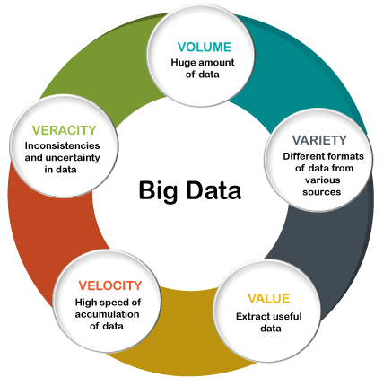
Big Data
Big data refers to large, complex datasets that cannot be effectively managed, processed, or analyzed using traditional data processing applications.
It encompasses three key dimensions commonly referred to as the three Vs:
volume,
velocity,
variety,
veracity
value

Slide 9
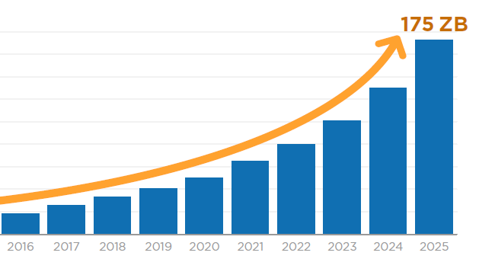
Big Data: Volume
Big data involves vast amounts of data generated from various sources, including
business transactions,
social media interactions,
sensor data,
machine-to-machine data, and more.
The sheer volume of data exceeds the capabilities of traditional database systems to store and manage efficiently.
This necessitates scalable storage solutions like distributed file systems and NoSQL databases.

Slide 10
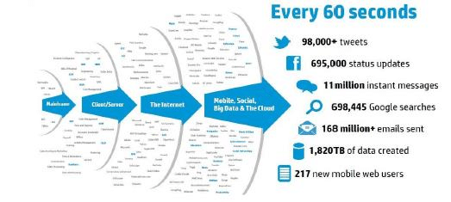
Big Data: Velocity
Big data is generated at high speed and must be processed quickly to extract timely insights.
Examples of high-velocity data include:
real-time sensor data,
social media updates,
financial transactions, and
website clickstreams.
Technologies like stream processing and real-time analytics platforms enable organizations to analyze data as it is being generated to make rapid decisions.

Slide 11
Big Data: Variety
Big data comes in diverse formats and types, including:
structured,
semi-structured, and
unstructured data.
Structured data follows a predefined format and is typically stored in relational databases.
Semi-structured data, such as XML and JSON, has some organizational properties but does not conform to a strict schema.
Unstructured data lacks a predefined structure and can include text documents, images, videos, and more. Managing and analyzing such diverse data types requires flexible data storage and processing solutions.

Slide 12
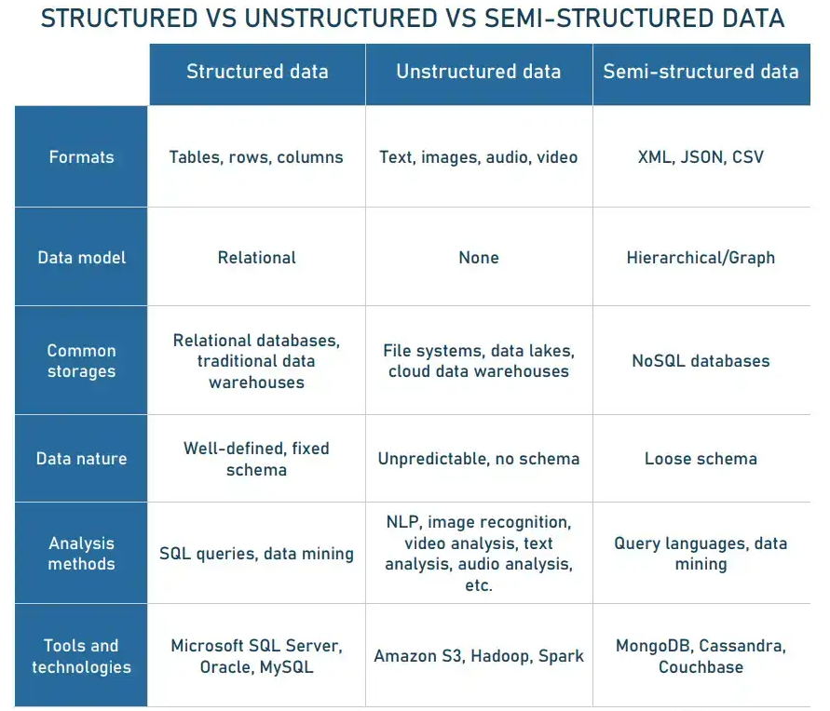
Types of Data
Data types have evolved over time to accommodate the diverse forms and sources of information.
The evolution of data types reflects the increasing complexity and diversity of data sources and the need for more adaptable storage and processing solutions to extract insights effectively.

Slide 13
Big Data: Veracity
Veracity refers to the:
quality,
accuracy, and
reliability of the data.
Big data often includes
noisy,
incomplete, or
inconsistent data from various sources.
posing challenges for analysis and decision-making.
Data quality and integrity must be ensured through data cleansing, validation, and quality assurance processes to derive accurate insights.

Slide 14
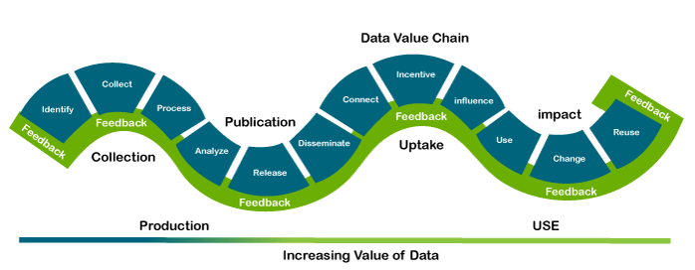
Big Data: Value
Value is an essential characteristic of big data. It is not the data that we process or store. It is valuable and reliable data that we store, process, and also analyze.

Slide 15
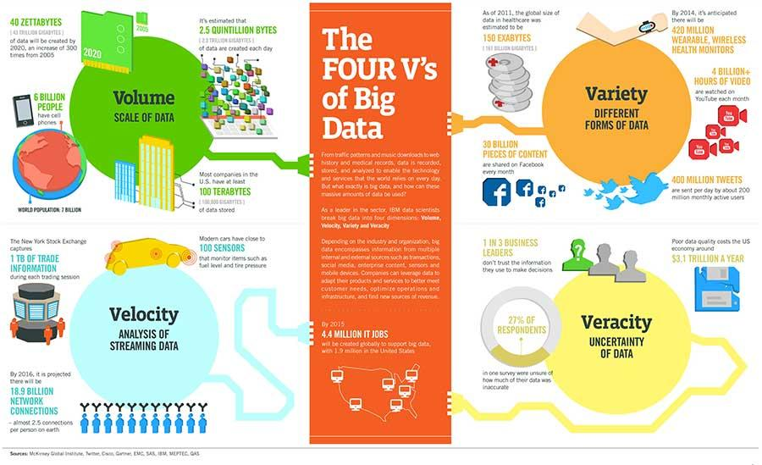

Slide 16
Big Data Generated from major Industries
Big data is generated across various industries as a result of digital transformation and the increasing adoption of technology in business processes. Here's a list of major industries where big data is commonly generated:
1. Finance and Banking: Financial institutions generate big data from transactions, customer interactions, market data, risk assessments, fraud detection, and regulatory compliance.
2. Healthcare and Life Sciences: Healthcare organizations produce big data from electronic health records (EHRs), medical imaging, wearable devices, genomic data, clinical trials, and patient monitoring systems.

Slide 17
Big Data Generated from major Industries
3. Retail and E-commerce: Retailers and e-commerce companies generate big data from sales transactions, customer interactions, website traffic, inventory management, supply chain operations, and marketing campaigns.
4. Telecommunications: Telecommunications companies produce big data from call detail records (CDRs), network traffic, customer interactions, location data, and device telemetry.
5. Manufacturing and Industrial: Manufacturing companies generate big data from production processes, sensor data, equipment telemetry, supply chain logistics, quality control, and predictive maintenance.

Slide 18
Big Data Generated from major Industries
5. Manufacturing and Industrial: Manufacturing companies generate big data from production processes, sensor data, equipment telemetry, supply chain logistics, quality control, and predictive maintenance.
6. Energy and Utilities: Energy and utility companies produce big data from smart meters, grid operations, sensor data from infrastructure, energy consumption patterns, and predictive maintenance of equipment.
7. Transportation and Logistics: Transportation and logistics companies generate big data from vehicle telemetry, GPS tracking, route optimization, shipment tracking, supply chain visibility, and fleet management.

Slide 19
Big Data Generated from major Industries
8. Media and Entertainment: Media and entertainment companies produce big data from digital media consumption, streaming services, social media interactions, content recommendations, and audience analytics.
9. Government and Public Sector: Government agencies and public sector organizations generate big data from census data, administrative records, geospatial data, public services, law enforcement, and regulatory compliance.
10. Education: Educational institutions generate big data from student records, learning management systems, online courses, assessments, research data, and academic performance metrics.

Slide 20
Big Data Generated from major Industries
Insurance
Hospitality and Travel
Marketing and Advertising
Agriculture
Real Estate

Slide 21
Big Data Analytics
Big data analytics is the process of analyzing large and complex datasets to uncover:
patterns,
trends,
correlations, and
Customer preferences
Meaningful/actionable information
other valuable insights
Which helps organizations make better decisions and solve problems.

Slide 22
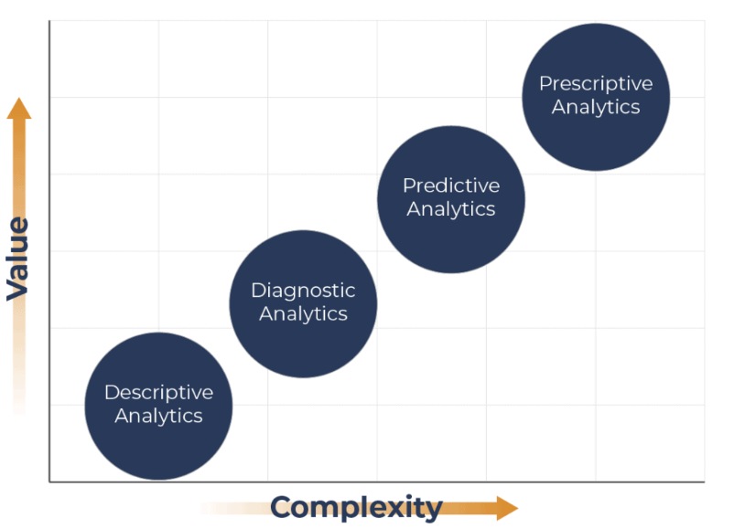
Types of Analytics

Slide 23
Descriptive Analytics
Descriptive analytics is a branch of analytics that focuses on summarizing and interpreting historical data to gain insights into past events, trends, and patterns.
It aims to answer the question "What happened?" by providing a comprehensive overview of the data and its characteristics.
Descriptive analytics forms the foundation of data analysis and is often the first step in the analytics process.
descriptive analytics provides valuable insights into historical data that can inform decision-making, support strategic planning, and drive business success.

Slide 24
key aspects of descriptive analytics
Data Summarization:
Descriptive analytics involves summarizing large and complex datasets into more manageable and understandable formats. This includes calculating summary statistics such as mean, median, mode, range, variance, and standard deviation to describe the central tendency, dispersion, and distribution of the data.
Data Visualization:
Visualization techniques such as charts, graphs, histograms, heatmaps, and dashboards are commonly used in descriptive analytics to represent data visually. Visualizations help identify trends, patterns, and outliers in the data more effectively than tabular formats.

Slide 25
key aspects of descriptive analytics
Data Exploration:
Descriptive analytics allows analysts to explore the underlying structure and relationships within the data. This involves examining different dimensions and attributes of the data to uncover insights and identify potential correlations or dependencies.
Pattern Recognition:
By analyzing historical data, descriptive analytics can reveal recurring patterns, trends, and anomalies that provide valuable insights into past behavior or performance. This information can be used to understand customer preferences, market dynamics, operational efficiencies, and more.

Slide 26
key aspects of descriptive analytics
Performance Monitoring:
Descriptive analytics is often used to monitor and track key performance indicators (KPIs) and metrics over time. By comparing current performance against historical benchmarks, organizations can assess their progress, identify areas for improvement, and make data-driven decisions.
Reporting and Dashboarding:
Descriptive analytics generates reports, summaries, and dashboards that communicate key findings and insights to stakeholders across the organization. These reports provide a snapshot of the current state of affairs and help support decision-making at various levels.

Slide 27
descriptive analytics in practice
Summarizing sales data by region, product category, or time period to identify trends and performance metrics.
Creating customer segmentation based on demographic characteristics, purchasing behavior, or engagement levels.
Analyzing website traffic patterns, clickstream data, and user interactions to understand website performance and user behavior.
Monitoring inventory levels, production output, and supply chain metrics to optimize operations and resource allocation.
Visualizing financial data such as revenue, expenses, and profitability to track financial performance and identify areas of concern.

Slide 28
Diagnostic Analytics
Diagnostic analytics is a branch of analytics that focuses on analyzing past data to identify the root causes of problems, anomalies, or unexpected events.
It aims to answer the question "Why did it happen?" by examining historical data in detail to understand the underlying factors and drivers that led to a particular outcome or issue.
Diagnostic analytics plays a critical role in uncovering insights into past performance, diagnosing problems, and informing corrective actions to address underlying issues.

Slide 29
key aspects of diagnostic analytics
Root Cause Analysis:
Diagnostic analytics involves conducting root cause analysis to investigate the underlying reasons or factors contributing to a specific outcome or event. It seeks to identify the primary causes or triggers that led to the observed behavior or result.
Pattern Recognition:
Diagnostic analytics examines historical data patterns, trends, and relationships to identify anomalies, deviations, or irregularities that deviate from expected norms or trends. It helps pinpoint areas of concern or areas where performance is suboptimal.

Slide 30
key aspects of diagnostic analytics
Correlation Analysis:
Diagnostic analytics assesses correlations and relationships between different variables, metrics, or factors to determine how changes in one variable impact others. This helps identify potential cause-and-effect relationships and dependencies.
Comparative Analysis:
Diagnostic analytics compares different segments, groups, or time periods to identify differences or discrepancies in performance. This includes comparing actual performance against benchmarks, targets, or historical baselines to assess performance relative to expectations.

Slide 31
key aspects of diagnostic analytics
Hypothesis Testing:
Diagnostic analytics formulates hypotheses or theories about the potential causes of observed outcomes and then tests these hypotheses using statistical methods and data analysis techniques. This helps validate assumptions and uncover insights into underlying drivers.
Drill-down Analysis:
Diagnostic analytics enables analysts to drill down into data at different levels of granularity, from high-level summaries to detailed transactional data. This allows for a more granular understanding of trends, patterns, and outliers within the data.

Slide 32
diagnostic analytics applications
Investigating Customer Complaints: Analyzing customer complaints data to identify common issues, trends, or patterns that may be indicative of underlying product or service problems.
Identifying Operational Bottlenecks: Analyzing production data to identify bottlenecks, inefficiencies, or quality issues in manufacturing processes and supply chains.
Root Cause Analysis of Equipment Failures: Investigating maintenance records and sensor data to identify root causes of equipment failures or breakdowns in industrial machinery or infrastructure.
Understanding Sales Performance Discrepancies: Analyzing sales data by region, product, or sales channel to understand variations in performance and identify factors influencing sales outcomes.
Analyzing Financial Performance Discrepancies: Investigating financial statements and transaction data to identify discrepancies, anomalies, or errors that may impact financial performance or reporting.

Slide 33
Predictive Analytics
Predictive analytics is a branch of advanced analytics that utilizes statistical algorithms, machine learning techniques, and data mining to forecast future events, behaviors, or trends based on historical data.
It aims to answer the question "What is likely to happen?" by analyzing patterns and relationships within data to make predictions about future outcomes.
Predictive analytics enables organizations to leverage data-driven insights to make more informed decisions, optimize resource allocation, enhance customer experiences, and gain a competitive advantage in various industries and domains.

Slide 34
key aspects of predictive analytics
Historical Data Analysis:
Predictive analytics starts by analyzing historical data to identify patterns, trends, and correlations that may be indicative of future behavior. This data can come from various sources, including transactions, customer interactions, sensor readings, social media, and more.
Feature Selection and Engineering:
Predictive analytics involves selecting and engineering relevant features or variables from the dataset that are likely to have predictive power. This process may include data preprocessing, cleaning, transformation, and feature extraction to improve model performance.

Slide 35
key aspects of predictive analytics
Model Building:
Predictive analytics builds mathematical models that capture the relationship between input variables (features) and the target variable (outcome). Common predictive modeling techniques include regression analysis, classification algorithms, time series forecasting, and ensemble methods.
Training and Validation:
Predictive models are trained using historical data, where the model learns patterns and relationships from the data. The model's performance is then evaluated using validation techniques such as cross-validation, holdout validation, or train-test split to assess its predictive accuracy and generalization capability.

Slide 36
key aspects of predictive analytics
Prediction and Forecasting:
Once trained and validated, predictive models are deployed to make predictions or forecasts on new or unseen data. These predictions provide insights into future outcomes, allowing organizations to anticipate trends, mitigate risks, and make proactive decisions.
Model Evaluation and Optimization:
Predictive models are continuously evaluated and optimized to improve their performance and accuracy. This may involve fine-tuning model parameters, selecting different algorithms, incorporating additional data sources, or updating the model over time as new data becomes available.

Slide 37
predictive analytics applications include
Sales Forecasting: Predicting future sales volumes based on historical sales data, market trends, and external factors such as economic indicators or seasonal patterns.
Customer Churn Prediction: Identifying customers who are at risk of churn (cancellation or defection) based on their behavior, usage patterns, and demographic characteristics.
Credit Risk Assessment: Evaluating the creditworthiness of applicants by analyzing their financial history, credit scores, payment behavior, and other relevant factors.
Demand Forecasting: Anticipating future demand for products or services to optimize inventory management, production planning, and supply chain logistics.
Healthcare Predictive Modeling: Predicting patient outcomes, disease diagnoses, or treatment responses based on medical history, genetic data, and clinical parameters.

Slide 38
Prescriptive Analytics
Prescriptive analytics is the most advanced form of analytics that focuses on recommending actions or decisions to achieve desired outcomes or objectives.
It goes beyond descriptive and predictive analytics, which describe what has happened and what is likely to happen, respectively, by providing actionable insights on what should be done and how to achieve it.
Prescriptive analytics aims to answer the question "What should we do?" by leveraging optimization, simulation, and decision-making algorithms to determine the best course of action based on data, constraints, and business objectives

Slide 39
key aspects of prescriptive analytics
Optimization:
Prescriptive analytics uses mathematical optimization techniques to identify the optimal solution to a problem from a set of possible alternatives. This involves defining objectives, constraints, and decision variables and then formulating and solving mathematical models to maximize or minimize the desired outcome.
Simulation:
Prescriptive analytics often employs simulation techniques to model complex systems, processes, or scenarios and evaluate the potential impact of different decisions or interventions. Simulation allows organizations to explore various what-if scenarios and assess the likely outcomes before implementing any changes.

Slide 40
key aspects of prescriptive analytics
Decision Support:
Prescriptive analytics provides decision support tools and recommendations to guide decision-makers in choosing the most effective or efficient course of action. These recommendations are based on quantitative analysis of data, business rules, optimization models, and user-defined preferences.
Trade-off Analysis:
Prescriptive analytics helps decision-makers evaluate trade-offs between competing objectives, resources, and constraints. It enables organizations to balance conflicting goals and make informed decisions that optimize overall performance or value.

Slide 41
key aspects of prescriptive analytics
Real-time Decision Making:
Prescriptive analytics can be applied in real-time or near real-time environments to support dynamic decision-making processes. This includes deploying prescriptive models and algorithms within operational systems to automate decision-making and response actions in rapidly changing environments.
Continuous Improvement:
Prescriptive analytics facilitates continuous improvement by enabling organizations to monitor, evaluate, and adapt their decision-making strategies over time. This involves feedback loops where performance data is collected, analyzed, and used to refine models, algorithms, and decision rules for ongoing optimization.

Slide 42
prescriptive analytics applications include
Supply Chain Optimization: Determining optimal inventory levels, production schedules, and distribution routes to minimize costs, reduce lead times, and improve service levels.
Resource Allocation: Optimizing resource allocation and workforce scheduling to maximize productivity, minimize idle time, and meet demand fluctuations.
Portfolio Optimization: Designing optimal investment portfolios that balance risk and return objectives based on market conditions, asset performance, and investor preferences.
Healthcare Treatment Planning: Personalizing treatment plans for patients based on medical history, genetic profiles, and clinical guidelines to optimize health outcomes and minimize risks.
Dynamic Pricing: Setting optimal prices for products or services in real-time based on demand, competition, and market conditions to maximize revenue and profitability.

Slide 43
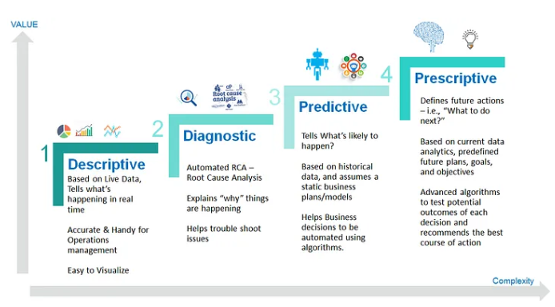

Slide 44
Case Study: Big data analytics for airline industry
In the airline industry, big data is generated from various sources, including:
Flight Data:
Each flight generates a wealth of data, including departure and arrival times, flight duration, distance traveled, aircraft type, fuel consumption, passenger information, ticket prices, and more.
Reservation Systems:
Airlines have reservation systems that track bookings, cancellations, seat availability, and passenger details.
Operational Data:
Data is collected from various operational aspects such as maintenance records, crew scheduling, baggage handling, and ground operations.

Slide 45
Case Study of airline industry
Customer Interactions:
This includes data from customer service interactions, feedback surveys, loyalty programs, social media, and website interactions.
Safety and Compliance:
Airlines gather data related to safety incidents, regulatory compliance, and security measures.
Financial Data:
Financial transactions, revenue streams, cost analysis, and profitability metrics contribute to big data in the airline industry.
Weather and Environmental Data:
Weather conditions play a significant role in flight operations, so airlines collect data on weather forecasts, historical weather patterns, and other environmental factors that can affect flights.

Slide 46
Case Study of airline industry
Market Trends:
Data on market trends, competitor analysis, and economic indicators help airlines make strategic decisions related to route planning, pricing, and marketing.
IoT Devices:
Internet of Things (IoT) devices installed in aircraft, such as sensors and monitoring systems, generate data on engine performance, fuel efficiency, and maintenance needs.
Third-party Sources:
Airlines may also integrate data from third-party sources such as government agencies, travel agencies, and industry partners to enrich their datasets.

Slide 47
Case Study: Big data analytics for airline industry
Predictive Maintenance:
Analyzing data from IoT sensors and maintenance records enables airlines to predict equipment failures and schedule maintenance proactively, reducing downtime and improving safety.
Route Optimization:
By analyzing historical flight data, weather patterns, fuel consumption, and passenger demand, airlines can optimize routes to minimize costs, reduce flight delays, and improve overall efficiency.
Customer Segmentation and Personalization:
Analyzing customer data allows airlines to segment passengers based on preferences, behavior, and demographics. This enables targeted marketing campaigns, personalized offers, and tailored services to enhance customer satisfaction and loyalty.

Slide 48
Case Study: Big data analytics for airline industry
Revenue Management:
Big data analytics helps airlines optimize pricing strategies by analyzing demand forecasts, competitor pricing, historical booking data, and market trends. This allows airlines to maximize revenue by adjusting ticket prices dynamically.
Operational Efficiency:
Analyzing operational data such as flight schedules, crew assignments, and ground operations helps airlines optimize resource allocation, streamline workflows, and improve overall operational efficiency.
Safety and Security:
Big data analytics enables airlines to analyze safety incident data, security threats, and regulatory compliance to identify potential risks and implement proactive measures to enhance safety and security protocols.

Slide 49
Case Study: Big data analytics for airline industry
Demand Forecasting:
Analyzing historical booking data, market trends, economic indicators, and seasonal patterns helps airlines forecast passenger demand accurately. This allows airlines to optimize capacity planning, adjust inventory levels, and allocate resources effectively.
Customer Experience Enhancement:
Analyzing customer feedback, social media sentiment, and service interactions helps airlines identify areas for improvement and enhance the overall customer experience. This includes improving service quality, addressing pain points, and optimizing customer touchpoints throughout the journey.

Slide 50
Case Study: Big data analytics for airline industry
Fuel Efficiency and Environmental Sustainability:
Analyzing fuel consumption data, flight trajectories, and environmental factors enables airlines to optimize fuel efficiency, reduce carbon emissions, and comply with environmental regulations.
Fraud Detection and Prevention:
Analyzing transaction data, booking patterns, and passenger behavior helps airlines detect and prevent fraudulent activities such as ticket fraud, loyalty program abuse, and payment fraud.

Slide 51
Exercise
For Retail Industry
Identify ways Big Data is generated
Big Data Analytics use cases

Slide 52
Day 2
Introduction to distributed computing frameworks (Hadoop, Spark).
Exploring data storage solutions: HDFS, data warehouses, data lakes.
Understanding data processing tools: MapReduce, Spark SQL.
Why Python is a popular choice for big data analytics.
Introduction to essential Python libraries for data analysis (NumPy, pandas, matplotlib).
Hands-on Lab: Setting up Python environment and exploring NumPy, pandas for data manipulation and visualization.
The importance of data cleaning and preparation before analysis.
Techniques for handling missing values, outliers, and data inconsistencies.
Transforming and shaping data for effective analysis.

Slide 53
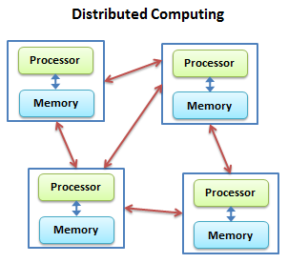
Distributed computing frameworks
Distributed computing frameworks are software systems designed to enable the processing of large-scale data or complex computational tasks across multiple interconnected computers, typically referred to as a cluster.
These frameworks distribute the workload among the nodes in the cluster, allowing for parallel and concurrent execution of tasks, which can lead to significant improvements in performance, scalability, and fault tolerance compared to traditional centralized computing systems.

Slide 54
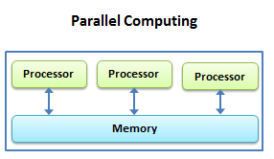
key aspects of distributed computing frameworks
Parallel Processing:
Distributed computing frameworks leverage parallel processing to divide tasks into smaller sub-tasks that can be executed concurrently across multiple nodes in the cluster.
This parallelism enables efficient utilization of computing resources and reduces the time required to complete tasks.

Slide 55
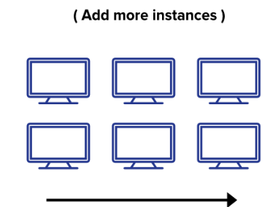
key aspects of distributed computing frameworks
Scalability:
Distributed computing frameworks are designed to scale horizontally by adding more nodes to the cluster as needed.
This allows organizations to handle increasing volumes of data or computational workloads without significant performance degradation or infrastructure overhauls.

Slide 56
key aspects of distributed computing frameworks
Fault Tolerance:
Distributed computing frameworks incorporate mechanisms for fault tolerance to ensure the reliability and availability of computing resources.
This includes features such as data replication, task reassignment, and fault recovery mechanisms to handle node failures, network partitions, or other system disruptions.
Data Distribution and Management:
Distributed computing frameworks provide tools for distributing and managing data across the cluster.
This may involve partitioning data into smaller chunks, replicating data for fault tolerance, and implementing distributed storage systems or file systems to ensure data availability and consistency.

Slide 57
key aspects of distributed computing frameworks
Resource Management:
Distributed computing frameworks include components for resource management, job scheduling, and task coordination across nodes in the cluster.
These components allocate computing resources (CPU, memory, storage) to tasks or jobs based on predefined policies, priorities, or resource constraints.
Programming Models and APIs:
Distributed computing frameworks offer programming models and APIs (Application Programming Interfaces) that developers can use to build distributed applications and perform parallel processing tasks. These programming models abstract away the complexities of distributed computing and provide higher-level abstractions for developers to work with.

Slide 58
key aspects of distributed computing frameworks
Support for Various Workloads:
Distributed computing frameworks support a wide range of workloads and use cases, including data processing, analytics, machine learning, streaming data processing, real-time event processing, graph processing, and more. They provide specialized libraries, tools, and APIs tailored to specific types of workloads.

Slide 59
Popular distributed computing frameworks
Apache Hadoop:
Primarily used for batch processing and distributed storage, Hadoop includes components like HDFS (Hadoop Distributed File System) and MapReduce for parallel data processing.
Apache Spark:
Known for its speed and versatility, Spark offers in-memory processing and supports various workloads including batch processing, interactive analytics, machine learning, and streaming data processing.

Slide 60
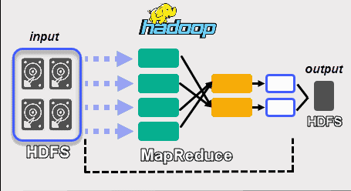
Apache Hadoop
Apache Hadoop is an open-source distributed computing framework designed for storing and processing large datasets across clusters of commodity hardware.
It is one of the most widely used frameworks for big data processing and analytics, known for its scalability, fault tolerance, and cost-effectiveness.
Hadoop is managed by the Apache Software Foundation and has become a foundational technology in the big data ecosystem.

Slide 61
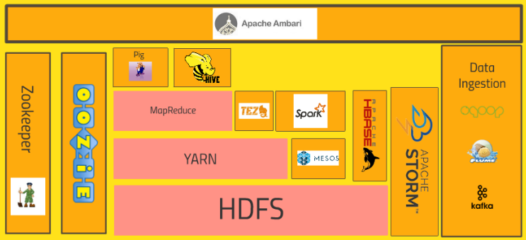
Apache Hadoop

Slide 62
Hadoop Distributed File System (HDFS)
HDFS is a distributed file system that provides scalable and reliable storage for large datasets across a cluster of computers.
It stores data in a distributed manner across multiple nodes in the cluster, with replication to ensure fault tolerance and data durability.
HDFS is optimized for high-throughput data access and is well-suited for storing large files, such as log files, sensor data, and web documents.

Slide 63
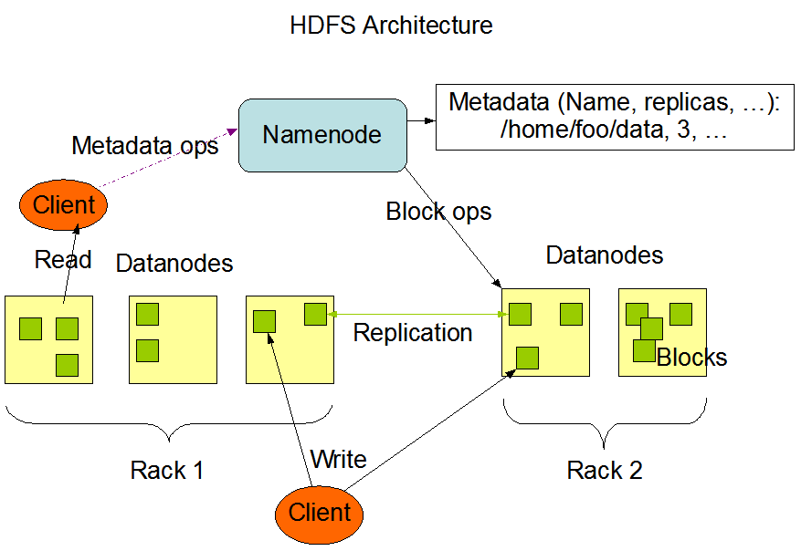
HDFS Architecture
HDFS has a master/slave architecture.
An HDFS cluster consists of a single NameNode, a master server that manages the file system namespace and regulates access to files by clients.
In addition, there are a number of DataNodes, usually one per node in the cluster, which manage storage attached to the nodes that they run on.
HDFS exposes a file system namespace and allows user data to be stored in files. Internally, a file is split into one or more blocks and these blocks are stored in a set of DataNodes.

Slide 64
HDFS Architecture
The NameNode executes file system namespace operations like opening, closing, and renaming files and directories. It also determines the mapping of blocks to DataNodes.
The DataNodes are responsible for serving read and write requests from the file system’s clients. The DataNodes also perform block creation, deletion, and replication upon instruction from the NameNode.

Slide 65
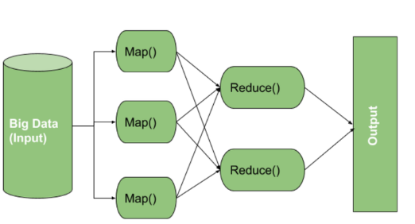
MapReduce
MapReduce is a programming model and processing engine for parallel data processing in Hadoop.
It divides tasks into smaller sub-tasks called "map" and "reduce" tasks, which are distributed across nodes in the cluster for parallel execution.
MapReduce is used for batch processing of large datasets, such as log analysis, ETL (Extract, Transform, Load) operations, and data aggregation.

Slide 66
YARN (Yet Another Resource Negotiator):
YARN is a resource management and job scheduling framework that manages computing resources (CPU, memory) across nodes in the Hadoop cluster.
It allows multiple data processing frameworks to run concurrently on the same cluster, enabling more flexible and efficient resource utilization.
YARN decouples the resource management layer from the processing framework, providing a more scalable and versatile architecture.

Slide 67
Hadoop Common:
Hadoop Common includes a set of utilities, libraries, and tools that provide common functionality for the Hadoop ecosystem.
It includes components such as the Hadoop Distributed Copy (DistCp) tool for data copying, Hadoop Archive (HAR) for archiving data, and Hadoop RPC (Remote Procedure Call) framework for communication between nodes.

Slide 68
Ecosystem of Tools and Projects
Hadoop has a rich ecosystem of tools and projects that extend its functionality and capabilities for various use cases.
These include higher-level data processing frameworks like Apache Hive for SQL-like querying.
Apache Pig for data flow scripting.
Apache HBase for NoSQL database operations.

Slide 69
Hadoop
Apache Hadoop is widely used across industries for various big data applications, including data warehousing, log analysis, recommendation systems, fraud detection, and genomic analysis.
It provides a scalable and cost-effective platform for processing and analyzing large volumes of data, enabling organizations to derive valuable insights and drive informed decision-making.

Slide 70
Install Hadoop and exercise
https://github.com/arjunachari12/hadoop-cluster-docker

Slide 71
Learn Python
https://github.com/arjunachari12/learn-python

Slide 72
Installation
Jupiter
https://jupyter.org/

Slide 73
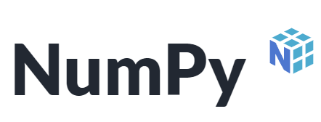
Essential Python libraries for data analysis
NumPy:
NumPy is a fundamental package for numerical computing in Python.
It provides support for multidimensional arrays, mathematical functions, random number generation, linear algebra, and more.
NumPy is often used as the foundation for other data analysis libraries in Python.
https://numpy.org/

Slide 74
NumPy key features
Arrays:
At the core of NumPy is the ndarray object, which represents a multidimensional, homogeneous array of fixed-size items. These arrays can be of any dimensionality and can contain elements of the same data type.
Vectorized Operations:
NumPy provides support for vectorized operations, allowing you to perform element-wise operations on arrays without the need for explicit looping in Python. This makes operations on large arrays much more efficient compared to traditional Python loops.
Mathematical Functions:
NumPy includes a wide range of mathematical functions for performing operations such as arithmetic, statistical, trigonometric, and linear algebraic computations on arrays.

Slide 75
NumPy key features
Broadcasting:
Broadcasting is a powerful mechanism in NumPy that allows arrays of different shapes to be combined together in element-wise operations. NumPy automatically broadcasts the smaller array to match the shape of the larger one, making it possible to perform operations on arrays of different sizes.
Indexing and Slicing:
NumPy provides advanced indexing and slicing capabilities for accessing and manipulating elements within arrays. This includes basic slicing, fancy indexing, and boolean indexing.

Slide 76
NumPy
Numerical Computations:
NumPy is used for numerical computing and performing mathematical operations on large arrays and matrices efficiently. It's particularly useful when dealing with numerical data in fields such as science, engineering, finance, and machine learning.
Array Operations:
NumPy provides powerful array operations, including element-wise operations, broadcasting, indexing, and slicing. It's commonly used for tasks like matrix multiplication, linear algebra operations, and statistical computations.

Slide 77
NumPy
Data Generation and Simulation:
NumPy's random module (numpy.random) is extensively used for generating random numbers from various probability distributions, which is essential for tasks like simulation, modeling, and statistical analysis.
Integration with Other Libraries:
NumPy arrays can be seamlessly integrated with other scientific libraries in Python, such as SciPy, Matplotlib, and scikit-learn. This interoperability makes it a foundational library in the Python scientific computing ecosystem.

Slide 78

Essential Python libraries for data analysis
pandas:
pandas is a powerful library for data manipulation and analysis in Python.
It provides data structures like DataFrame and Series, which allow for easy handling of structured data.
pandas offers functionality for reading and writing data from various file formats, data cleaning, reshaping, merging, grouping, and statistical analysis.
https://pandas.pydata.org/

Slide 79
key features
Data Structures:
Series: A one-dimensional array-like object containing an array of data and an associated array of labels, called the index.
DataFrame: A two-dimensional labeled data structure with columns of potentially different types. It is similar to a spreadsheet or SQL table, and it provides powerful indexing, slicing, and reshaping capabilities.
Data Manipulation:
Cleaning Data: Pandas provides functions for handling missing data, removing duplicates, and filling in missing values using methods like dropna(), fillna(), and drop_duplicates().

Slide 80
key features
Data Transformation:
Pandas allows for reshaping and transforming data using functions like pivot_table(), melt(), stack(), and unstack(). This is useful for tasks like aggregating data, pivoting tables, and converting data between wide and long formats.
Data Merging and Joining:
Pandas provides functions like merge() and concat() for combining data from multiple sources based on common columns or indices. This is useful for joining datasets, merging data frames, and performing relational database-style operations.
Data Filtering and Selection:
Pandas provides powerful methods for filtering and selecting data based on conditions, labels, or positions. This includes methods like loc[] and iloc[] for label-based and integer-based indexing, as well as boolean indexing and query expressions.

Slide 81
key features
Data Analysis:
Descriptive Statistics:
Pandas offers functions for computing summary statistics, such as mean, median, standard deviation, and quartiles, using methods like describe(), mean(), median(), and std().
GroupBy Operations:
Pandas supports splitting, applying, and combining data using the groupby() function, allowing for group-wise operations and aggregations on data frames.
Time Series Analysis:
Pandas provides extensive support for working with time series data, including date/time indexing, resampling, shifting, and rolling window calculations.

Slide 82
key features
Data Input and Output:
Pandas supports reading and writing data from various file formats, including CSV, Excel, JSON, SQL databases, and HDF5. This makes it easy to load data into memory for analysis and export results to different formats.
Overall, Pandas is widely used in data analysis, data cleaning, data transformation, and exploratory data analysis (EDA) tasks.
It provides a convenient and efficient way to work with structured data in Python and is an essential tool for anyone working with data in Python.

Slide 83
Pandas
Data Manipulation:
Pandas is primarily used for data manipulation and analysis, particularly for structured data. It provides data structures like Series and DataFrame, which offer powerful ways to work with labeled and relational data.
Data Cleaning and Preprocessing:
Pandas is commonly used for tasks like cleaning messy data, handling missing values, and transforming data into a suitable format for analysis. Its intuitive API makes it easy to perform tasks like filtering, sorting, and aggregating data.

Slide 84
Pandas
Data Exploration and Analysis:
Pandas is widely used for exploring and analyzing datasets, including tasks like descriptive statistics, data visualization, and time series analysis. It provides high-level functions that simplify common data analysis tasks.
Data Integration and IO:
Pandas offers tools for reading and writing data from various file formats, including CSV, Excel, SQL databases, and JSON. It simplifies the process of loading data into memory for analysis and exporting results to different formats.

Slide 85

Essential Python libraries for data analysis
Matplotlib:
Matplotlib is a comprehensive library for creating static, interactive, and animated visualizations in Python.
It provides a MATLAB-like interface for creating plots and charts, including line plots, scatter plots, bar plots, histograms, heatmaps, and more.
Matplotlib is highly customizable and can be used to create publication-quality graphics for data analysis and presentation.
https://matplotlib.org/

Slide 86
Essential Python libraries for data analysis
Seaborn:
Seaborn is built on top of Matplotlib and provides a higher-level interface for creating statistical visualizations in Python.
scikit-learn:
scikit-learn is a popular machine learning library for Python, providing tools for data preprocessing, model selection, evaluation, and deployment.
SciPy:
SciPy is a library for scientific computing in Python, built on top of NumPy.
StatsModels:
StatsModels is a Python library for statistical modeling and hypothesis testing.

Slide 87
Use Cases
Financial Analysis:
NumPy and Pandas are commonly used for financial modeling, quantitative analysis, and portfolio optimization.
Data Science:
Both libraries are indispensable for data science tasks, including data cleaning, exploratory data analysis (EDA), feature engineering, and model evaluation.
Machine Learning:
NumPy arrays are the standard data format for inputting data into machine learning models, while Pandas is often used for data preprocessing and feature extraction.

Slide 88
Use Cases
Time Series Analysis:
Pandas provides powerful tools for working with time series data, such as resampling, date/time indexing, and rolling windows calculations.
Data Visualization:
While neither library is primarily focused on visualization, they are often used in conjunction with visualization libraries like Matplotlib and Seaborn to analyze and visualize data effectively.

Slide 89
Exercise Python Libraries
https://github.com/arjunachari12/big-data-analytics-basics/blob/main/day2/sample.py

Slide 90
The importance of data cleaning and preparation before analysis
Data cleaning and preparation are essential steps in the data analysis process, and their importance cannot be overstated. Here are some key reasons why data cleaning and preparation are crucial:
Ensuring Data Quality:
Raw data often contains errors, inconsistencies, missing values, and outliers. Data cleaning helps identify and rectify these issues, ensuring that the data is accurate, reliable, and of high quality.
Improving Analysis Accuracy:
Clean and well-prepared data leads to more accurate and reliable analysis results. By addressing data errors and inconsistencies, you reduce the risk of drawing incorrect conclusions or making flawed decisions based on faulty data.
Enhancing Model Performance:
In machine learning and statistical modeling, the quality of input data significantly impacts model performance. Clean and properly formatted data improves the training process, leading to more effective and robust models with better predictive accuracy.

Slide 91
The importance of data cleaning and preparation before analysis
Facilitating Data Exploration:
Data cleaning and preparation make it easier to explore and understand the data. By organizing the data, resolving inconsistencies, and handling missing values, analysts can focus on extracting insights and patterns rather than dealing with data issues.
Enabling Comparative Analysis:
Consistent data formatting and normalization enable meaningful comparisons between different datasets or subsets of data. This is particularly important when analyzing data from multiple sources or across different time periods.
Supporting Reproducibility:
Clean and well-documented data cleaning and preparation procedures support reproducibility in data analysis. By following standardized processes and documenting data transformations, other analysts can replicate the analysis and verify the results.

Slide 92
The importance of data cleaning and preparation before analysis
Reducing Bias and Error Propagation:
Data cleaning helps mitigate bias and error propagation in the analysis process. By identifying and addressing biases or errors early on, you minimize their impact on downstream analysis and decision-making.
Complying with Regulations:
In many industries, there are regulations and standards governing data quality and privacy. Data cleaning and preparation ensure compliance with these regulations by maintaining data integrity, confidentiality, and security.
Overall, data cleaning and preparation are foundational steps in the data analysis workflow. They set the stage for accurate analysis, reliable insights, and informed decision-making, ultimately maximizing the value derived from data assets.

Slide 93
Techniques for handling missing values, outliers, and data
inconsistencies.
Handling missing values, outliers, and data inconsistencies is an essential aspect of data cleaning and preparation. Here are some techniques commonly used for each of these tasks:
Handling Missing Values:
Deletion: Remove rows or columns with missing values. This approach is suitable when the amount of missing data is small and does not significantly affect the analysis.
Imputation: Fill missing values with a suitable estimate. Common imputation techniques include:
Mean/Median/Mode Imputation: Replace missing values with the mean, median, or mode of the respective column.
Forward Fill/Backward Fill: Fill missing values with the last known value (forward fill) or the next known value (backward fill).
Interpolation: Estimate missing values based on the surrounding data points using techniques like linear interpolation or spline interpolation.
Advanced Techniques: More advanced methods such as K-Nearest Neighbors (KNN) imputation, regression imputation, or machine learning-based imputation can be used for more accurate estimation of missing values.

Slide 94
Techniques for handling missing values, outliers, and data inconsistencies.
Handling Outliers:
Identification: Use visualization techniques such as box plots, histograms, or scatter plots to identify outliers visually. Statistical methods like z-score or interquartile range (IQR) can also be used to detect outliers quantitatively.
Treatment:
Winsorization: Replace outliers with the nearest non-outlier value (e.g., 5th percentile for low outliers and 95th percentile for high outliers).
Trimming: Remove extreme values from the dataset.
Transformation: Apply mathematical transformations (e.g., log transformation) to make the distribution more symmetric and reduce the impact of outliers.
Domain Knowledge: Consider the domain context when deciding how to handle outliers. Sometimes, outliers may represent genuine data points that are important for the analysis.

Slide 95
Transforming and shaping data for effective analysis
Transforming and shaping data for effective analysis is a critical step in the data preparation process. It involves restructuring, aggregating, and organizing data to make it suitable for analysis and visualization. Here are some techniques for transforming and shaping data:
Data Cleaning:
Handling Missing Values: Impute or remove missing values to ensure data completeness.
Handling Outliers: Identify and treat outliers to prevent them from skewing analysis results.
Standardizing Data Formats: Ensure consistent data formats, units, and conventions across the dataset.
Data Reshaping:
Pivoting: Convert data from long to wide format or vice versa using the pivot or melt functions in pandas.
Stacking and Unstacking: Reshape hierarchical index levels using the stack and unstack functions in pandas.
Transposing: Switch rows and columns using the transpose or T attribute in pandas DataFrames.

Slide 96
Transforming and shaping data for effective analysis
Data Aggregation:
Grouping: Aggregate data by one or more variables using the groupby function in pandas. Apply aggregation functions like sum, mean, count, etc., to the grouped data.
Rolling and Expanding Windows: Compute rolling or expanding statistics over time series data using the rolling and expanding functions in pandas.
Pivot Tables: Create summary tables of aggregated data using pivot tables in pandas.
Data Transformation:
Feature Engineering: Create new features from existing ones to capture additional information or improve model performance. This may involve mathematical transformations, binning, encoding categorical variables, or extracting date/time features.
Normalization and Standardization: Scale numerical features to a common range or standardize them to have a mean of 0 and a standard deviation of 1.
Logarithmic Transformation: Transform skewed data distributions using logarithmic transformations to make them more symmetric.

Slide 97
Transforming and shaping data for effective analysis
Data Integration and Enrichment:
Merging and Joining: Combine data from multiple sources using merge and join operations in pandas. Merge on common keys or indices to create a unified dataset.
Data Enrichment: Enhance existing datasets with additional information from external sources. This could involve merging demographic data, geographic data, or other contextual information with the original dataset.
Data Reduction:
Dimensionality Reduction: Reduce the number of features in the dataset using techniques like principal component analysis (PCA) or feature selection methods to focus on the most informative variables.
Sampling: Reduce the size of large datasets by sampling a subset of observations or aggregating data at a higher level of granularity.
By applying these techniques, you can transform and shape your data in a way that makes it more suitable for analysis, modeling, and visualization, ultimately leading to more meaningful insights and better decision-making.

Slide 98
End to end analysis to solve churn prediction
Step 1: Data Collection
- Obtain the historical data on customer demographics, usage patterns, and churn status from the telecommunications company's database or data source.
Step 2: Data Preprocessing with pandas
- Use pandas to load the dataset into a DataFrame.
- Handle missing values, if any, by imputing or dropping them.
- Encode categorical variables using one-hot encoding or label encoding.
- Split the data into training and testing sets.

Slide 99
Steps to build analytical solutions
Step 3: Exploratory Data Analysis (EDA) with pandas and Matplotlib/Seaborn
- Calculate summary statistics using pandas to understand the distribution of variables.
- Visualize data distributions, correlations, and patterns using Matplotlib or Seaborn.
- Explore relationships between features and the target variable (churn).
Step 4: Feature Engineering with pandas and NumPy
- Engineer new features or transform existing ones to improve model performance.
- Perform feature scaling or normalization, if necessary.
- Select relevant features based on EDA and domain knowledge.

Slide 100
Steps to build analytical solutions
Step 5: Model Building with scikit-learn
- Train machine learning models using scikit-learn, such as logistic regression, decision trees, random forests, or gradient boosting.
- Evaluate model performance using metrics like accuracy, precision, recall, F1-score, and ROC-AUC.
- Experiment with different algorithms and hyperparameters to find the best-performing model.
Step 6: Model Evaluation and Validation with scikit-learn
- Validate model performance using techniques like cross-validation to ensure generalization.
- Fine-tune model hyperparameters using grid search or random search.
- Evaluate the final model on the testing set to estimate its performance on unseen data.

Slide 101
Steps to build analytical solutions
Step 7: Deployment and Integration
- Deploy the churn prediction model into production using frameworks like Flask or FastAPI for building RESTful APIs.
- Integrate the model into the company's existing systems or applications for real-time predictions.
- Monitor model performance and retrain periodically to maintain accuracy and relevance.

